Slide 1
Chapter 00_03
Introducing Foundation

Slide 2

Body of Knowledge Coverage:
Basis Analysis (AL)
Basis Analysis (AL)
Asymptotic Analysis, empirical measurement.
Differences among best, average, and worst case behaviors of an algorithm.
Complexity classes, such as constant, logarithmic linear, quadratic, and exponential.
Recurrence Relations and their solutions.
Time and space trade-offs in algorithms.

Slide 3
Modular Arithmetic for Applications to Cryptography

Slide 4


Outlines
Division Theorem, the remainder, x modulo y (7, 8)
Congruent modulo n, and modular equivalence (9, 10, 12, 16, 17, 18, 21, 23)
Compute $a^{k} mod n,$ when k is a power of 2. (31-36, 39-41)

Slide 5
Elementary Number-Theoretic Notions
An application of number-theoretic algorithms is in cryptography
the discipline concerned with encrypting a message sent from one party to another, such that someone who intercepts the message will not be able to decode it.
Let the set Z = { …., -2, -1, 0, 1, 2, 3, ….} of integers.
Let the set N = {0, 1, 2, 3, ….} of natural numbers (also non-negative integers).
The notation d | a (read “d divides a”) means
a = k*d for some integer k, (i.e., a is k multiple of d).

Slide 6

The Division Theorem, Remainders, and Modular Equivalence
For any two integers x and y, where y ≠ 0,
the quotient q of x divided by y is given by
q = └ $\frac{x}{y}$ ┘
the remainder r of dividing x by y is given by
r = x – q*y.
Algorithm divide(x, y), x$≥$ 0, y $≥$ 1
q = 0; r = x;
while (r $≥$ y) {
r = r – y;
q ++; };
output q, r;

Slide 7


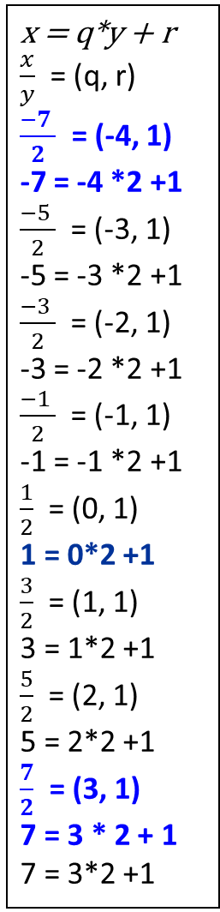
The Division Theorem, Remainders, and Modular Equivalence
Theorem 0.1(Division Theorem)
For any integer x and any positive integer y,
there are unique integers q and r such that 0 ≤ r < y and x = q*y + r.
Proof: Followed by definition. QED
Definition of x mod y
x mod y is the remainder r = x – q*y, where q = └ x / y ┘.
x = q*y + r
$\frac{x}{y}$ = (q, r)
$\frac{−7 }{2}$ = (-4, 1)
-7 = -4 *2 +1
$\frac{−5 }{2}$ = (-3, 1)
-5 = -3 *2 +1
$\frac{−3 }{2}$ = (-2, 1)
-3 = -2 *2 +1
$\frac{−1 }{2}$ = (-1, 1)
-1 = -1 *2 +1
$\frac{1}{2}$ = (0, 1)
1 = 0*2 +1
$\frac{3}{2}$ = (1, 1)
3 = 1*2 +1
$\frac{5}{2}$ = (2, 1)
5 = 2*2 +1
$\frac{7}{2}$ = (3, 1)
7 = 3 * 2 + 1
7 = 3*2 +1
[0]₂ = { …, -8, -6, -4, -2, 0, 2, 4, 6, 8, 10, 12, 14, 16, 18, … } is the equivalence class modulo 2 containing 0.
[1]₂ = { …, -7, -5, -3, -1, 1, 3, 5, 7, 9, 11, 13, 15, 17, 19, … } is the equivalence class modulo 2 containing 1.
x = {[r]_{y} | x = q * y + r, 0 ≤ r < y }.

Slide 8

x mod y is the remainder of $\frac{x}{y}$ :
Definition of x mod y
x mod y is the remainder r = x – q*y, where q = └ $\frac{x}{y}$ ┘.
Example: -18 mod 7 = 3, 3 = -18 - (-3) * 7.
-11 mod 7 = 3, 3 = -11 - (-2) * 7.
- 4 mod 7 = 3, 3 = -4 - (-1) * 7.
3 mod 7 = 3, 3 = 3 - 0 * 7.
10 mod 7 = 3, 3 = 10 - 1 * 7.
17 mod 7 = 3, 3 = 17 - 2 * 7.
[3]₇ = { …,-18, -11. -4, 3, 10, 17, …} is the equivalence class modulo 7 containing 3. x = {[r]_{y} | x = q * y + r, 0 ≤ r < y }.
Denote “ y divides x” as y | x.
y | x means that x = i * y for some integer i.
y | x iff x mod y = 0.

Slide 9


Congruence Modulo n
Definition of Congruent Modulo n:
Let m and k be integers and n be a positive integer (n > 0).
m is congruent to k modulo n
(or we say, m and k are congruent modulo n)
(or we say, m and k are equivalent ($≡$) mod n)
denoted as
m $≡$k mod n
if, and only if n | (m – k) or n | (k – m).
Example: -18 $≡3$ mod 7, -11 $≡3$ mod 7, -4 $≡3$ mod 7, 10 $≡3$ mod 7,
17 $≡3$ mod 7, 24 $≡$3 mod 7, 31 $≡3$ mod 7, 38 $≡3$ mod 7, …
Observation:
n | (m – k) or n | (k – m). m mod n = k mod n (i.e., they have the same remainder.
m = k + i * n, where i ɛ Z = {…, -2, -1, 0, 1, 2, …}

Slide 10

m = q * n + r, q = i, r = k
m = i * n + k, 0 ≤ k < n
m = i * 7 + 3
When i $∈$ {0, 1, 2, 3, …}, m $∈$ {3, 10, 17, 24, …}, respectively.
When i $∈$ {-1, -2, -3, …}, m $∈$ {- 4, -11, -18, …}, respectively.
Congruent modulo n:
m and k are congruent modulo n
if they differ by a multiple of n (i.e., i * n).
Equivalently, we write |m – k| = i * n,
for some i ɛ Z = {…, -2, -1, 0, 1, 2, …}, the set of integers.
Example:
[k]_{n} =[3]₇ = {m} = {… -11, - 4, 3, 10, 17, 24, 31, …} are congruent modulo 7.
[3]₇ is the equivalent class modulo 7 containing 3.
|(-4) - 3| = 1 * 7, |-11 - 3| = 2 * 7, |-18 - 3| = 3 * 7,
|-25 - 3| = 4 * 7, |-32 - 3| = 5 * 7, …
|3 - 3| = 0 * 7, | 10 - 3| = 1 * 7, |17 - 3| = 2 * 7
|24 - 3| = 3 * 7, | 31 - 3| = 4 * 7, |38 - 3| = 5 * 7, …

Slide 11
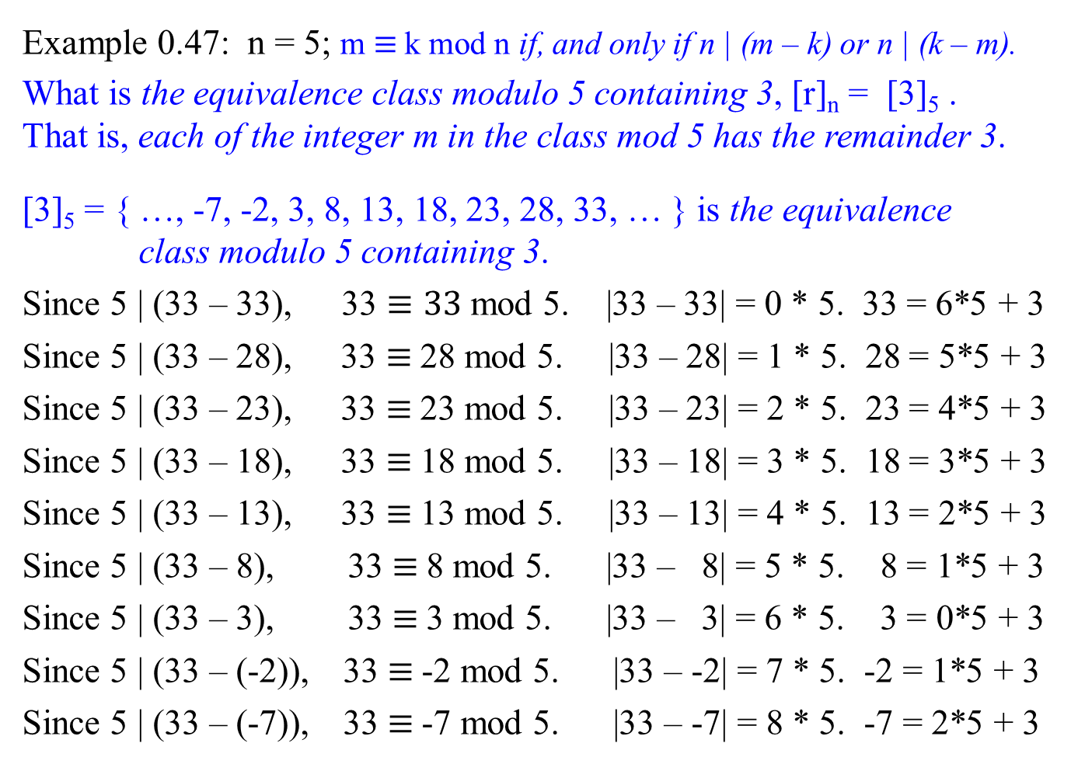
Congruence Modulo n
Example 0.47: n = 5; m $≡$k mod n if, and only if n | (m – k) or n | (k – m).
What is the equivalence class modulo 5 containing 3, [r]_{n} = [3]₅ .
That is, each of the integer m in the class mod 5 has the remainder 3.
[3]₅ = { …, -7, -2, 3, 8, 13, 18, 23, 28, 33, … } is the equivalence class modulo 5 containing 3.
Since 5 | (33 – 33), 33 $≡33$ mod 5. |33 – 33| = 0 * 5. 33 = 6*5 + 3
Since 5 | (33 – 28), 33 $≡$28 mod 5. |33 – 28| = 1 * 5. 28 = 5*5 + 3
Since 5 | (33 – 23), 33 $≡$23 mod 5. |33 – 23| = 2 * 5. 23 = 4*5 + 3
Since 5 | (33 – 18), 33 $≡$18 mod 5. |33 – 18| = 3 * 5. 18 = 3*5 + 3
Since 5 | (33 – 13), 33 $≡$13 mod 5. |33 – 13| = 4 * 5. 13 = 2*5 + 3
Since 5 | (33 – 8), 33 $≡$8 mod 5. |33 – 8| = 5 * 5. 8 = 1*5 + 3
Since 5 | (33 – 3), 33 $≡$3 mod 5. |33 – 3| = 6 * 5. 3 = 0*5 + 3
Since 5 | (33 – (-2)), 33 $≡$-2 mod 5. |33 – -2| = 7 * 5. -2 = 1*5 + 3
Since 5 | (33 – (-7)), 33 $≡$-7 mod 5. |33 – -7| = 8 * 5. -7 = 2*5 + 3
x = q*y + r

Slide 12


Congruence Modulo n
[3]₅ = { …, -7, -2, 3, 8, 13, 18, 23, 28, 33, … } is the equivalence class modulo 5 containing 3.
Theorem 0.1.4.1 Modular Equivalences
Let a, b, and n be any integers. Let n > 1.
The following statements are all equivalent:
n | (a – b)
a $≡$b (mod n), a is congruent to b modulo n
a = b + i*n for some integer i, the division theorem a = i*n + b
a and b have the same (nonnegative) remainder when divided by n;
i.e., $\frac{a}{n}$ = $\frac{b}{n}$ = r
5. a mod n = b mod n.
Proof: Obvious. Example: 5 | (33 -18).

Slide 13
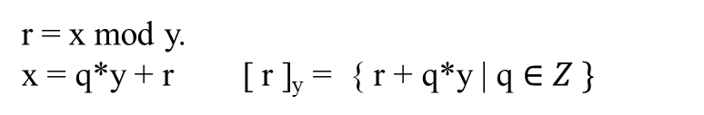

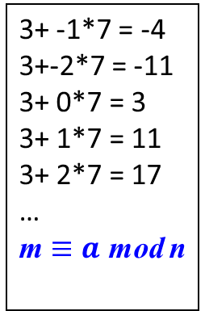
r = x mod y.
x = q*y + r [ r ]_{y} = { r + q*y | q $∈Z \}$
Let Z be the set of integers {…, -2, -1, 0, 1, 2, … }.
All integers can be partitioned into n equivalence classes, according to their remainders modulo n.
Define the equivalence class modulo n containing an integer a to be
[a]_{n} = {a + i * n | i ɛ Z},
For example, [3]₇ = { …, - 25, -18, -11, -4, 3, 10, 17, 24, 31, 38, …}.
i.e., b $∈$ [a]_{n} iff b ≡ a (mod n).
iff n | (b – a). i.e., b must be equal to a + i*n.
3+ -1*7 = -4
3+-2*7 = -11
3+ 0*7 = 3
3+ 1*7 = 11
3+ 2*7 = 17
…
m $≡a$ mod n

Slide 14


b $∈$ [a]_{n} iff b ≡ a (mod n). i.e., a and b are in the same class [a]_{n.}
The set of all such equivalence classes Z_{n} is
Z_{n} = {[a]_{n} | 0 ≤ a ≤ n – 1 }. i.e., z = i * n + a, 0 ≤ a < n.
There are seven equivalence classes modulo 7.
Z₇ = {[0]₇, [1]₇, [2]₇, …, [6]₇} where
[0]₇ = { …, -14, -7, 0, 7, 14, 21,…} 21 ≡ 0 (mod 7), (21 – 0) / 7 = 0
[1]₇ = { …, -13, -6, 1, 8, 15, 22,…} 22 ≡ 1 (mod 7), (22 – 1) / 7 = 0
[2]₇ = { …, -12, -5, 2, 9, 16, 23,…} 23 ≡ 2 (mod 7), (23 – 2) / 7 = 0
[3]₇ = { …, -11, -4, 3, 10, 17, 24,…} 24 ≡ 3 (mod 7), (24 – 3) / 7 = 0
…
[6]₇ = { …, -8, -1, 6, 13, 20, 27,… } 27 ≡ 6 (mod 7), (27 – 6) / 7 = 0

Slide 15

Congruence Modulo n
Congruence modulo n is an equivalence ($≡$) relation on the set of all integers.
Theorem 0.1.4.2 Congruence Modulo n is an Equivalence Relation
Let n > 1 be any integer. The distinct equivalence classes of the relation are the sets [0]_{n}, [1]_{n}, [2]_{n}, …, [n – 1]_{n}, where for each a = 0, 1, 2, …, n -1,
[a]_{n} = {m $∈$ Z | m $≡$ a (mod n)},
or, equivalently,
[a]_{n} = {m $∈$ Z | m $=$i*n + a for some integer i}.
Proof: Left for exercise.
Example: The equivalence class mod 7 containing 3 is
[3]₇ = {3, 10, 17, 24, …}.

Slide 16
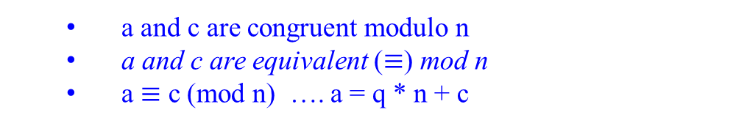

Congruence Modulo n
a and c are congruent modulo n
a and c are equivalent ($≡$) mod n
a $≡$ c (mod n) …. a = q * n + c
Theorem 0.1.4.3 Modular Arithmetic (Substitution Rules)
Let a, b, c, d, and n be integers with n > 1.
If a $≡$ c (mod n) and b $≡$ d (mod n)
then
(a + b) $≡$ (c + d) (mod n)
(a - b) $≡$ (c - d) (mod n)
a b $≡$ c d (mod n)
a^{m} $≡$ c^{m} (mod n) for all integers m.
Proof: left for exercise.

Slide 17

Congruence Modulo n
Corollary 0.1.4.4
Let a, b, and n be integers with n> 1. Then
a b $≡$ [(a mod n) (b mod n)] (mod n),
or, equivalently,
a b $mod n=$ [(a mod n) (b mod n)] (mod n).
If m is a positive integer, then
a^{m} $≡$ [(a mod n)^{m}] (mod n).
or, equivalently,
a^{m} $mod n=$ [(a mod n)^{m}] (mod n).
e.g., 32¹⁰⁰ $mod 31=$ [(32 mod 31)¹⁰⁰] (mod 31)
= [(1)¹⁰⁰] (mod 31) = 1(mod 31) = 1.

Slide 18

Some of the properties: Modular arithmetic (a, b are integers, n is a positive integer)
(a + b) mod n = (a mod n + b mod n) mod n
(a * b) mod n = ((a mod n) * (b mod n)) mod n
Example:
(15 + 21) mod 5 = 36 mod 5 $≡$ 1
(15 + 21) mod 5 = (15 mod 5 + 21 mod 5) mod 5
= (0 + 1) mod 5 $≡$ 1
(32*32) mod 31 = ((32 mod 31) * (32 mod 31) ) mod 31
= 1 mod 31 $≡$ 1, where as 1024 mod 31 $≡$ 1

Slide 19

Congruence Modulo n
Example: Using Corollary 0.1.4.4
(55 * 26) mod 4 = {(55 mod 4) (26 mod 4) mod 4
= (3 * 2) mod 4
= 6 mod 4
$≡$ 2
That is, 2 $≡$ (55 * 26) mod 4
or (55 * 26) $≡$ 2 mod 4

Slide 20
Under such substitution, addition, multiplication remain well-defined.
Substitution rule:
If x ≡ x’ (mod N) and y ≡ y’ (mod N), then
x + y ≡ x’ + y’ (mod N) and xy ≡ x’y’ (mod N)
Example:
For 16 ≡ 7 mod 3, and 2 ≡ 17 mod 3
then (16 +2) ≡ (7 + 17) mod 3.
i.e., 18 ≡ 24 mod 3 iff 3 | (24 -18).
Or
(16 + 17) ≡ (7 + 2) mod 3.
i.e., 33 ≡ 9 mod 3 iff 3 | (33 – 9).

Slide 21


Example:
Suppose we watch an entire season of our favorite television show in one sitting, starting at midnight. There are 25 episodes, each lasting 3 hours. At what time of day are we done?
The answer is: The hour of completion is (25 * 3) (mod 24), which is 3 am.
A day has 24 hours. Since 3(mod 24) = 3 and 25 (mod 24) = 1
(25 * 3) (mod 24) = ( 25 (mod 24) * 3 (mod 24))(mod 24)
= 1 * 3 (mod 24)
= 3 (mod 24)
≡ 3 am. {because the process begins at 0:00 midnight.
What if there are 40 episodes? Then the completion is (40 * 3) mod 24 = 0 (12 midnight).
What if there are 45 episodes? Then the completion is (45 * 3) mod 24 = 15 (3 pm).
What if there are 125 episodes? Then the completion is (125 * 3) mod 24 = (5*3) mod 24 = 15 (3 pm)

Slide 22
Modular arithmetic satisfies associative, commutative and distribute properties of addition and multiplication.
x + (y + z) ≡ ( x + y) + z (mod N) Associativity
xy ≡ yx (mod N) Commutativity
x (y + z) ≡ ( xy + yz) (mod N) Distributivity
While performing a sequence of arithmetic operations, it is legal to reduce intermediate results to their remainders modulo N at any stage. Such simplifications can be a dramatic help in big calculations.

Slide 23


1024(2¹⁰), 512(2⁹), 256(2⁸), 128(2⁷), 64(2⁶), 32(2⁵), 16, 8, 4, 2, 1(2⁰)
1 1 1 1 1 1 1 1 1 1 1
begin
(a * b) mod n = ((a mod n) * (b mod n)) mod n
Example 0.21: Compute 2³⁴⁵ mod 31.
2³⁴⁵ = ( 2⁵ ) ⁶⁹ = ( 32 ) ⁶⁹ and 1 ≡ 32 (mod 31)
2³⁴⁵ (mod 31)
= ( 2⁵ ) ⁶⁹ (mod 31)
= ( 2⁵ (mod 31)) ⁶⁹ (mod 31)
= 1 ⁶⁹ (mod 31)
$≡$ 1
Also, compute 2³⁴⁵.
2³⁴⁵ = ( 2⁵ ) ⁶⁹ = ( 32 ) ⁶⁹ = … Then what?
Compute 2³⁴⁵ (mod 15).
2³⁴⁵ (mod 15)
= ( 2⁴ ) ⁸⁶ x 2 (mod 15)
= ( 2⁴ ) ⁸⁶ (mod 15) x 2 (mod 15)
= ( 2⁴ mod 15) ⁸⁶ (mod 15) x 2 (mod 15)
= 1 x 2
$≡$ 2

Slide 24

Note that 2² = 2 * 2 = 10₂ * 10₂ = 100₂ = 4
This allows you to use shifting left for your multiplication.
For example: compute (32)⁴
32 = 1 0 0 0 0 0
x 32 = 1 0 0 0 0 0 … 2⁵
1024 = 1 0 0 0 0 0 0 0 0 0 0 ….sL 5 bits, 2¹⁰
x 32 = 1 0 0 0 0 0 … 2⁵
32768 = 1 0 0 0 0 0 0 0 0 0 0 0 0 0 0 0 … sL 5 bits, 2¹⁵
x 32 = 1 0 0 0 0 0 . . . 2⁵
1048576 = 1 0 0 0 0 0 0 0 0 0 0 0 0 0 0 0 0 0 0 0 0 … sL 5 bits, 2²⁰

Slide 25

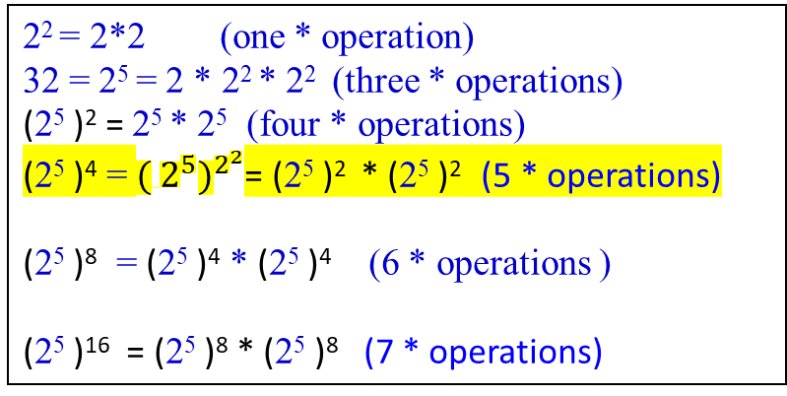
Back to the original problem to compute 2³⁴⁵ : which needs 344 * operations.
2³⁴⁵ = ( 2⁵ )⁶⁹
= ( 32 )⁶⁹
= ( 32 )¹⁰⁰⁰¹⁰¹ or = ( 32 )⁶⁸ * ( 32 )¹
= ( 32 )⁶⁴ * ( 32 )⁴ * ( 32 )¹
= (( 32 )⁴ )¹⁶ * ( 32 ) ⁴ * ( 32 )¹
= ((( ( (32)⁴ )² )² )² )² * (32)⁴ * ( 32 )¹
= ( ( ((32)⁴ * (32)⁴)² )²)² * (32)⁴ * ( 32 )¹
= (( ((32)⁴*(32)⁴)*((32)⁴*(32)⁴) )²)²*(32)⁴*(32)¹
= (( ((32)⁴*(32)⁴)*((32)⁴*(32)⁴) * ((32)⁴*(32)⁴)*((32)⁴*(32)⁴)))²*(32)⁴*(32)¹
= (( ((32)⁴*(32)⁴)*((32)⁴*(32)⁴) * ((32)⁴*(32)⁴)*((32)⁴*(32)⁴) ) *
(( ((32)⁴*(32)⁴)*((32)⁴*(32)⁴) * ((32)⁴*(32)⁴)*((32)⁴*(32)⁴) ))*(32)⁴*(32)¹
which requires 6 * operations, given (32)⁴. The total is 11 * operations, given 2.
2² = 2*2 (one * operation)
32 = 2⁵ = 2 * 2² * 2² (three * operations)
(2⁵ )² = 2⁵ * 2⁵ (four * operations)
(2⁵ )⁴ = ${( 2^{5})}^{2^{2}}$= (2⁵ )² * (2⁵ )² (5 * operations)
(2⁵ )⁸ = (2⁵ )⁴ * (2⁵ )⁴ (6 * operations )
(2⁵ )¹⁶ = (2⁵ )⁸ * (2⁵ )⁸ (7 * operations)
(32)⁴ = (32*32)* (32*32) which requires
2 * operations, given 2⁵ = 32. Total is 5 * operations.

Slide 26

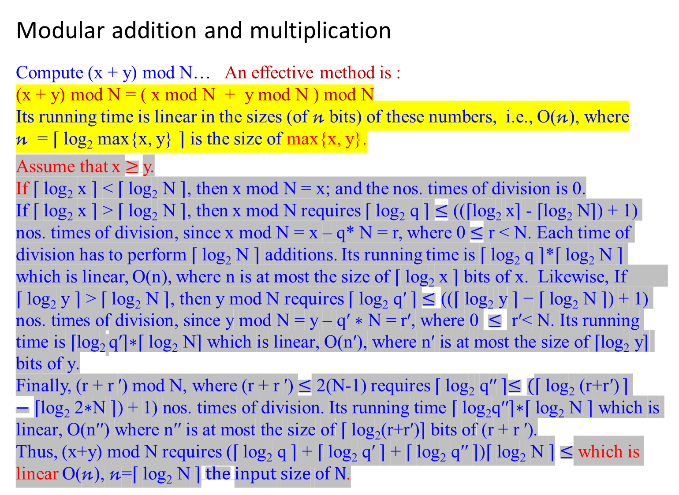
Modular addition and multiplication
Compute (x + y) mod N… An effective method is :
(x + y) mod N = ( x mod N + y mod N ) mod N
Its running time is linear in the sizes (of $\text{n}$ bits) of these numbers, i.e., O($\text{n}$), where
$\text{n}$ = ⌈ log₂ max{x, y} ⌉ is the size of max{x, y}.
Assume that x $≥$y.
If ⌈ log₂ x ⌉ < ⌈ log₂ N ⌉, then x mod N = x; and the nos. times of division is 0.
If ⌈ log₂ x ⌉ > ⌈ log₂ N ⌉, then x mod N requires ⌈ log₂ q ⌉ $≤$ ((⌈log₂ x⌉ - ⌈log₂ N⌉) + 1) nos. times of division, since x mod N = x – q* N = r, where 0 $≤$ r < N. Each time of division has to perform ⌈ log₂ N ⌉ additions. Its running time is ⌈ log₂ q ⌉*⌈ log₂ N ⌉ which is linear, O(n), where n is at most the size of ⌈ log₂ x ⌉ bits of x. Likewise, If ⌈ log₂ y ⌉ > ⌈ log₂ N ⌉, then y mod N requires ⌈ log₂ q$\text{′}$ ⌉ $≤\text{((⌈ }\text{log}\text{2} \text{y}\text{ ⌉ − ⌈ }\text{log}\text{2} \text{N}\text{ ⌉) + 1) }\text{nos}\text{. }\text{times} \text{of} \text{division}\text{, }\text{since} \text{y} \text{mod} \text{N}\text{ = }\text{y}\text{ – }\text{q}\text{′ }\text{∗ }\text{N}\text{ = }\text{r}\text{′, }\text{where}\text{ 0 }≤ \text{r}\text{′< }\text{N}\text{. }\text{Its} \text{running} \text{time} \text{is}\text{ ⌈}\text{log}\text{2} \text{q}\text{′⌉∗⌈ }\text{log}\text{2} \text{N}\text{⌉ }\text{which} \text{is} \text{linear}\text{, }\text{O}\text{(}\text{n}\text{′), }\text{where} \text{n}\text{′ }\text{is} \text{at} \text{most} \text{the} \text{size} \text{of}\text{ ⌈}\text{log}\text{2} \text{y}\text{⌉ }\text{bits} \text{of} \text{y}\text{.}$
Finally, (r + r $\text{′}$) mod N, where (r + r $\text{′}$) $≤$ 2(N-1) requires ⌈ log₂ q$\text{′′}$ ⌉$≤($⌈ log₂ (r+r$\text{′}$) ⌉ $−\text{⌈}\text{log}\text{2} \text{2∗}\text{N}\text{ ⌉) + 1) }\text{nos}\text{. }\text{times} \text{of} \text{division}\text{.}$ $\text{Its} \text{running} \text{time}\text{ ⌈ }\text{log}\text{2}\text{q}\text{′′⌉∗⌈ }\text{log}\text{2} \text{N}\text{ ⌉ }\text{which} \text{is} \text{linear}\text{, }\text{O}\text{(}\text{n}\text{′′) }\text{where} \text{n}\text{′′ }\text{is} \text{at} \text{most} \text{the} \text{size} \text{of}\text{ ⌈ }\text{log}\text{2}\text{(}\text{r}\text{+}\text{r}\text{′)⌉ }\text{bits} \text{of} \text{(}\text{r}\text{ + }\text{r} \text{′)}$.
Thus, (x+y) mod N requires (⌈ log₂ q ⌉ + ⌈ log₂ q$\text{′}$ ⌉ + ⌈ log₂ q$\text{′′}$ ⌉)$\text{⌈ }\text{log}\text{2} \text{N}\text{ ⌉}≤$ which is linear $\text{O}\text{(}\text{n}\text{)}\text{, }\text{n}\text{=}\text{⌈ }\text{log}\text{2} \text{N}\text{ ⌉} the \text{input} \text{size} \text{of} \text{N}$.
11 mod 4
= 7 mod 4
= 3 mod 4
= 3
10
100 1011
100
11

Slide 27
31 0 1 1 1 1 1
345 1011 1 0 1 0 1 1 0 0 1
33 1 0 1 1
15 1 0 1 0 1
11 1 0 1 1
4 1 0 1 0 0
1 0 1 1
1 0 0 1 0
1 0 1 1 1 1 1 1 1 0 1 1
1 0 0
Let x = 345 and N = 11.
⌈ log₂ x ⌉ = 9 bits.
⌈ log₂ N ⌉ = 4 bits.
The nos. of divisions needed
is 9-4+1 = 6 additions.

Slide 28
1 0 1 1 1 0 1 0 0 0
1 0 1 1 1 1 1 1 1 1 1 1 1 1 1 1 1
1 0 1 1
1 0 0 1
0 0 0 0
1 0 0 1 1
1 0 1 1
1 0 0 0 1
1 0 1 1
1 1 0 1
1 0 1 1
1 0 1
0
1 0 1 1
1 0 1 1
0 1
0
0 1 1
0
0 1 1 1
0
0 1 1 1
⌈ log₂ x ⌉ = 13 bits
⌈ log₂ N ⌉ = 4 bits
The nos. of division needed is 13-4+1 = 10 additions
7 4 4
11 8 1 9 1
7 7
4 9
4 4
5 1
4 4
7

Slide 29


Example:
Let N be 31.
Let x and y be 30
(x * y) mod N
= 30*30 mod 31
= 30 * 30
= (N – 1)²
Let x and y be n bits long.
x*y would be 2n bits long.
The size of (N – 1)² is log₂ (N -1)²
≤ └ (N -1)² ┘ + 1 = 2n
Compute xy (mod N) ….. multiplying x mod N and y mod N
(x * y) mod N = ((x mod N) * (y mod N)) mod N
To multiply two mod N numbers x and y,
start with regular multiplication, x*y and
then reduce the answer modulo N.
The product can be as large as (N -1)² .
This is still at most 2n bits long since log(N -1)² = 2log( N – 1 ) ≤ 2n.
[Rationalize: let n = ⌈ log₂ (N-1) ⌉, where 2^{n-1} ≤ N-1 < 2^{n .} We have (N-1)² < 2^{2n}.
Then log₂(N-1)² < log₂2^{2n}. We obtain 2log₂ (N-1) < 2nlog₂2.
That is, ⌈ log₂ (N-1)² ⌉ ≤ 2n.]
To reduce the answer modulo N, we compute the remainder upon dividing it by N, using a quadratic-time division algorithm. Thus, multiplication remains a quadratic operation.
If N $≠$ 0, division can be done in cubic time, O(n³).

Slide 30
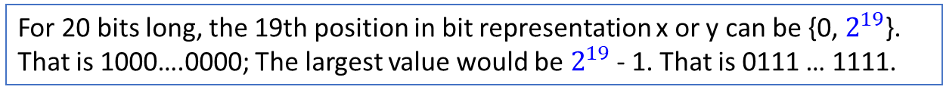

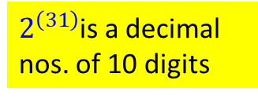
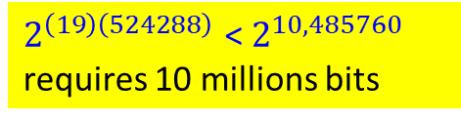
For 20 bits long, the 19th position in bit representation x or y can be {0, $2^{19}$}.
That is 1000….0000; The largest value would be $2^{19}$ - 1. That is 0111 … 1111.
Modular exponentiation
Any cryptography system needs a fast way to compute x^{y} mod N, where values x, y, and N of several hundred bits long each.
The result is some number modulo N and a few hundred bits long.
The raw value of x^{y} could be much longer than this.
When both x and y are 20 bits numbers [bit positions are from 0 to 19],
x^{y} is at least ${(2^{19} )}^{(2^{19} )}$ = $2^{\left(19\right)\left(524288\right) }$about 10 million bits long!
Image what happens if y is a 500-bit number!
Compute x^{y} mod N by repeatedly multiplying x modulo N to yield
x mod N $→$ x² mod N $→$ x³ mod N $→$ x⁴ mod N $→$ … $→$ x^{y} mod N.
A problem arises: We need to perform all intermediate computations modulo N.
We need to perform y – 1 (i.e., $≈$ $2^{500}$) multiplications if y is 500 bits long.
This approach is clearly exponential in the size of y.
$2^{\left(31\right)}$is a decimal nos. of 10 digits
$2^{\left(19\right)\left(524288\right) }$< $2^{10,485760 }$
requires 10 millions bits

Slide 31


Can we do better to compute x^{y} mod N?
Starting with x and squaring repeatedly modulo N, compute
x mod N
x² mod N = (x mod N) (x mod N ) mod N
x⁴ mod N = (x² mod N) (x² mod N ) mod N
x⁸ mod N = (x⁴ mod N) (x⁴ mod N ) mod N
…
x^{y} mod N = ($x^{\frac{y}{2}}$ mod N) ($x^{\frac{y}{2}}$ mod N ) mod N.
x mod N $→$ x² mod N $→$ x⁴ mod N $→$ x⁸ mod N $→$ … $→$ ${\text{x}}^{2^{\text{⌈}\text{log}\text{2} \text{y}\text{⌉}}}$ mod N, where 2^{k} = y which implies k = $\text{⌈ }\text{log}\text{2} \text{y}\text{ ⌉}$. That is, 2^{k} = $2^{\text{⌈}\text{l}\text{og}\text{2} \text{y}\text{⌉}}.$
Each takes just O(log₂² N) time to compute, and in this case, there are only $\text{log}\text{2}$ y multiplications. Thus, O($\text{log}\text{2}$ y * log₂² N), a polynomial time.
Takes O(log₂² N) time to compute x² mod N = (x mod N * x mod N)mod N, since it takes O(log₂ N) to compute x mod N.

Slide 32



To determine x^{y} mod N, multiply simply together an appropriate subset of these powers, those corresponding to 1’s in the binary representation of y.
For example,
$$x^{25} = x^{{11001}_{2}}= x^{{10000}_{2}}∗ x^{{1000}_{2}}∗ x^{1_{2}}= x^{16}∗ x^{8}∗ x^{1}$$
$x^{1}$
$x^{2}$ $= x^{1}∗ x^{1}$
$x^{4}$ $= x^{2}∗ x^{2}$
$x^{8}$ $= x^{4}∗ x^{4}$
$x^{16}= x^{8}∗ x^{8}$
Then, compute ${ x}^{16} ∗ x^{8}∗ x^{1}$
A polynomial-time algorithm is finally within reach!
X², X⁴, X⁸, and X¹⁶ require 4 multiply operations. Thus, ${ x}^{16} ∗ x^{8}∗ x^{1}$ require 6 multiply operations; The input size of y is
└ (log₂ 25 ┘ + 1

Slide 33

Figure 1.4 Modular exponentiation
function modexp(x, y, N)
//Compute x^{y} mod N
Input: Two n-bits integers x and N, an integer exponent y.
Output: x^{y} mod N.
if (y = 0) then return 1;
z = modexp(x, └y/2┘, N); // z = x^{└ y/2 ┘} mod N
if (y is even) then return z² mod N;
else return x * z² mod N;

Slide 34
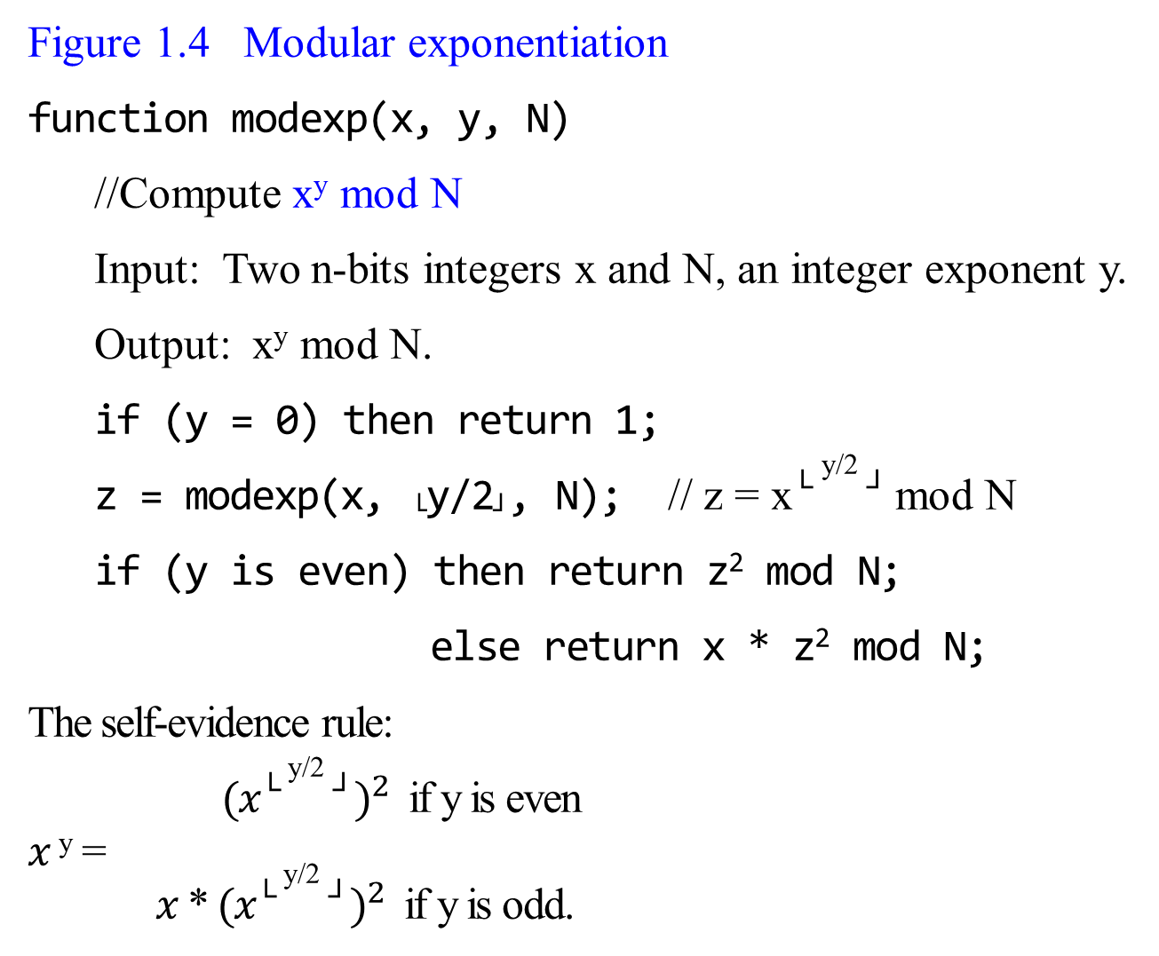
Figure 1.4 Modular exponentiation
function modexp(x, y, N)
//Compute x^{y} mod N
Input: Two n-bits integers x and N, an integer exponent y.
Output: x^{y} mod N.
if (y = 0) then return 1;
z = modexp(x, └y/2┘, N); // z = x^{└ y/2 ┘} mod N
if (y is even) then return z² mod N;
else return x * z² mod N;
The self-evidence rule:
${ (x\text{└ }\text{y}\text{/2 ┘})}^{2}$ if y is even
$x$^{y} =
$x$ * ${(x\text{└ }\text{y}\text{/2 ┘})}^{2}$ if y is odd.
Compute x¹¹ mod N
me(x, 11, N)
z = me(x, └11/2┘, N);
z = me(x, └5/2┘, N);
z = me(x, └2/2┘, N);
z = me(x, └1/2┘, N);
z = me(x, └0/2┘, N);
if (y = 0), return 1.
z = me(x, └0/2┘, N) = 1
z = me(x, └1/2┘, N);
if (y is even) … else x * 1² mod N
z = me(x, └1/2┘, N)= x mod N
z = me(x, └2/2┘, N);
if (y is even) then (x mod N)² mod N
z = me(x, └2/2┘, N)= (x² mod N) mod N
z = me(x, └5/2┘, N);
if (y is even) then x * ((x² mod N) mod N)² mod N
z = me(x, └11/2┘, N);
if (y is even) then x* (x * ((x² mod N) mod N)² mod N)² mod N

Slide 35


For computing x^{y} mod N,
let n be the size in bit-representation max{x, y, N}.
The algorithm will halt after at most n recursive calls, where n = ( └ log₂ n ┘ + 1) bits $≅$log₂ n, since └y/2┘ for each recursive call.
During each call it multiplies n-bit numbers (doing computation modulo N save us here).
The total running time is log₂ n * O(n² ) $≤$ O(n³ ).
This recursive algorithm of Figure 1.4, which works by executing, modulo N, the self-evident rule
(x^{└ y/2 ┘})² if y is even
x^{y} =
x * (x^{└ y/2 ┘})² if y is odd

Slide 36

function modexp(x, y, N) {
if (y = 0) then return 1;
z = modexp(x, └ y/2 ┘, N);
if (y is even) then return z² mod N
else return x* z² mod N; }
Example 0.25: Compute x²⁵
x²⁵ = x * x²⁴
= x * ( x¹² )²
= x * ( ( x⁶ )² )²
= x * ( ( ( x³ )² )² )²
= x * ( ( ( x * ( x¹ )² )² )² )²
= x * ( ( ( x * ( x * x⁰ )² )² )² )²
This closely parallels our recursive multiplication algorithm
(Figure 1.1 Multiplication à la Franҫais).

Slide 37

Example 0.25: Compute x²⁵ %N
modexp(x, 25, N); z = ME(x, └ 25/2 ┘, N);
x²⁵ = x * x²⁴
= x * ( x¹² )²
= x * ( ( x⁶ )² )²
= x * ( ( ( x³ )² )² )²
= x * ( ( ( x * ( x¹ )² )² )² )²
= x * ( ( ( x * ( x * x⁰ )² )² )² )²
This closely parallels our recursive multiplication algorithm
(Figure 1.1 Multiplication à la Franҫais).
function modexp(x, y, N) {
if (y = 0) then return 1;
z = modexp(x, └ y/2 ┘, N);
if (y is even) then return z² mod N
else return x* z² mod N; }
ME(x, 25, N)
y =25 $≠$0; z = x * (((x * ((x * 1² ) %N)² %N )² %N )² %N )² %N
z = ME(x, └ 25/2 ┘, N);
y =12 $≠$0; z = ((x * ((x * 1² ) %N)² %N )² %N )² %N
z = ME(x, └ 12/2 ┘, N);
y =6 $≠$0; z = (x * ((x * 1² ) %N)² %N )² %N
z = ME(x, └ 6/2 ┘, N);
y =3 $≠$0; z = x * ((x * 1² ) %N)² %N
z = ME(x, └ 3/2 ┘, N);
y =1 $≠$0; z = (x * 1² ) %N
z = ME(x, └ 1/2 ┘, N);
y = 0; z = x⁰ = 1

Slide 38

For RSA cryptography, computations are facilitated by using two properties of exponents:
x^{2n} = (x^{n})² for all real numbers x and a with x $≥$ 0. ……..(e.0.1.4.1)
x^{a+b} = xªx^{b} for all real numbers x, a and b with x $≥$ 0. ……..(e.0.1.4.2)
Example:
x⁴ mod n = (x²)² mod n
= (x² mod n)² mod n, using Corollary 0.1.4.4
Example:
x⁷ mod n = (x⁴⁺²⁺¹) mod n
= (x⁴x² x¹) mod n
= {(x⁴ mod n) (x² mod n)(x¹ mod n)} mod n

Slide 39


Example: Compute $a^{k} mod n,$ when k is a power of 2.
Find ${144}^{4}$ mod 713.
Solution:
Use the property of $x^{2a} =({x^{a})}^{2}$ for all real numbers x and a with x $≥0.$
144 mod 713 = 144
${144}^{2}$ mod 713 = $20736 mod 713$ = 59
${144}^{4}$ mod 713 $=({{144}^{2})}^{2}$ mod 713
$=({{144}^{2} mod 713)}^{2}$ mod 713
$=({20736 mod 713)}^{2}$ mod 713
$= {59}^{2}$ mod 713
$=3481$mod 713
$=629$

Slide 40

Example: Compute $a^{k} mod n,$ when k is a power of 2.
Find ${12}^{43}$ mod 713.
Solution:
First write the exponent as a sum of powers of 2:
43 = $2^{5}+$ ${2 }^{3} +$ $2+1=32+8+2+1.$
Next compute ${{12}^{2}}^{k} for k=1, 2, 3, 4, 5$
12 mod 713 = 12
1$2^{2}$ mod 713 = 144
1$2^{4}$ mod 713 = ${144}^{2}$ mod 713 = 59
1$2^{8}$ mod 713 = ${ 59}^{2}$ mod 713 = 629
1$2^{16}$ mod 713 = ${629}^{2}$ mod 713 = 639
1$2^{32}$ mod 713 = ${ 639}^{2}$ mod 713 = 485
Use the property of $x^{a+b} =x^{a}$ $x^{b}$for all real numbers x and a, and b with x $≥0.$
1$2^{43}=\text{1}2^{32+8+2+1}$ = 1$2^{32}$ 1$2^{8}$ 1$2^{2}$ 1$2^{1}$
${12}^{43}$ mod 713 $=((\text{1}2^{32} \text{mod}\text{ 713) (1}2^{8} \text{mod}\text{ 713) (1}2^{2}mod 713) \text{(}\text{1}2^{1}$mod 713) ) mod 713
$=\left(485 ∗629 ∗144 ∗12\right)$mod 713
$= 527152320$ mod 713 = 48
43 = 1 0 1 0 1 1
floor(log₂ 43) = 5 + 1 bits
For n bits long, it needs floor(log₂ n) bits.
Each has to do at most 2 mod and 1 multiple.
These can be done by 3*floor(log₂ n) of divide/multiple operations.
These can be done by at most floor(log₂ n) - 1 of multiple/divide operations.

Slide 41
In summary,
Adding x and y takes O(n);
Multiplying x and y takes O(n² );
Computing x^{y} mod N takes O(log² N) time; and
Dividing x by y takes O(n² )

